Slide 1
Musical Instrument Classification Using a Hybrid Neural Network
Landon Buell
Senior, Physics B.S. Major
University of New Hampshire
8 Jan 2020
Kevin Short
University Professor & Professor of Mathematics
Founder, Integrated Applied Mathematics Program
University of New Hampshire

Slide 2
Introduction

Slide 3
Presentation Outline
Problem that we are going to solve
Introduce Nerual Networks as the solution
Discuss consequences and improvements to the solution
Analyze the performance of the solution

Slide 4
Mapping Sounds to Sources
Humans are proficient at mapping sounds to sources
Impractical at a large scale
Computers are not proficient at mapping sounds to sources
Can handle large volumes of data

Slide 5
“Birds inspired us to fly, burdock plants inspired Velcro and nature has inspired many other inventions. It seems only logical then, to look to the brain’s architecture for inspiration on how to build an intelligent machine.”
- Aurelion Geron, Former YouTube Video Classification lead

Slide 6
The Neural Network

Slide 7
Structure
Consider a neural network to be just like mathematical function
Composed of smaller functions called layers
Transform features into predictions

Slide 8
Classification Model
Inputs are properties of digital audio files from London’s Philharmonia Orchestra and University of Iowa’s Electronic Music Studios
Outputs are integers that correspond to musical instruments
We group samples with similar input properties

Slide 9




The Multilayer Perceptron (MLP)
$$x^{(l−1)}$$
$$x^{(l−1)}$$
$$W^{(l)}$$
$$x^{(l)}$$

Slide 10
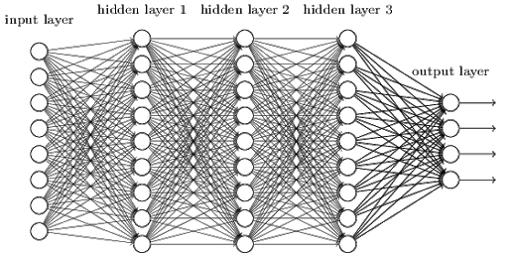
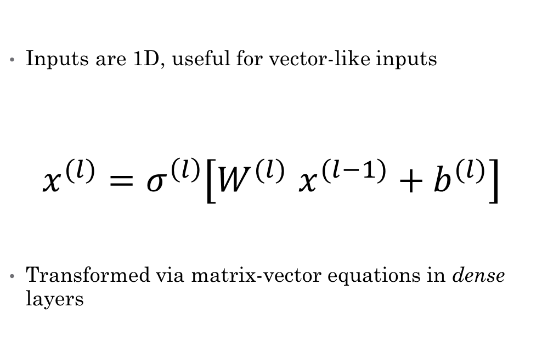
The Multilayer Perceptron (Cont.)
Inputs are 1D, useful for vector-like inputs
$$x^{(l)}=σ^{\left(l\right)}\left[W^{(l)} x^{(l−1)}+b^{(l)}\right]$$
Transformed via matrix-vector equations in dense layers

Slide 11
Features for the MLP
Time Domain Envelope (x5)
Zero Crossing Rate
Temporal Center of Mass
Auto Correlation Coefficients (x4)
Mel Frequency Cepstrum Coefficients (x12)
Frequency Center of Mass

Slide 12
The Convolutional Network (CNN)

Slide 13
Consequence of the Solutions
Both architectures has experimentally shown individual success
MLP and CNN use different forms of inputs they are initially incompatible
We want to combine them to form a Hybrid Neural Network

Slide 14
Hybrid Network Architecture

Slide 15
Two Modes of Input
Each model uses a different input Modes
1D Feature Vector vs.
2D Spectrogram Image
Compare Modes to human senses

Slide 16
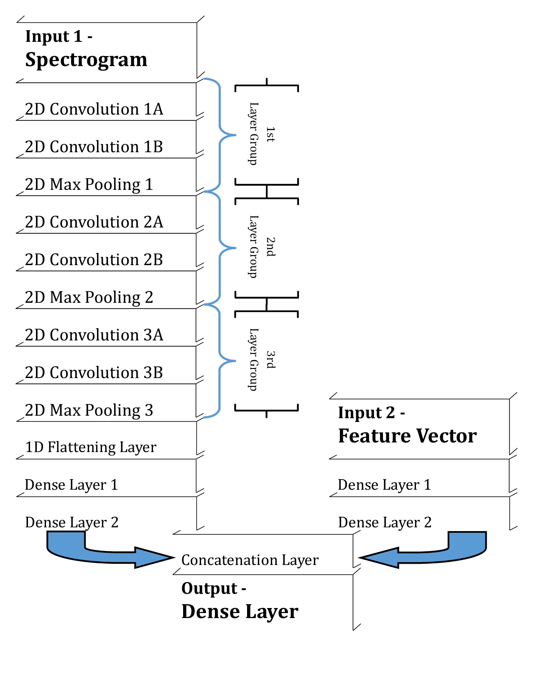
Hybrid Neural Network Architecture

Slide 17
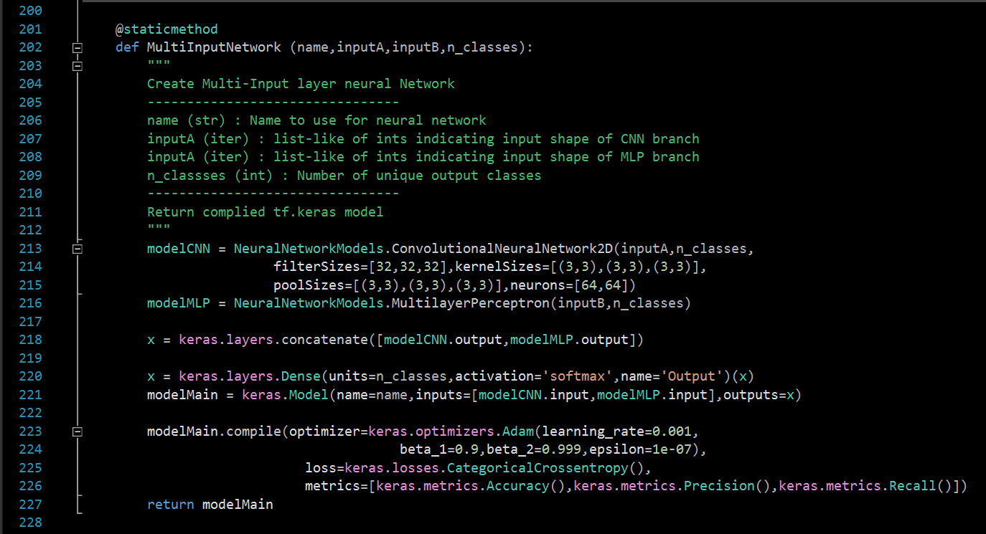
Implementation (Tensorflow.keras)
Create each input Branch as its own model
Concatenation of each model’s output activations
Create combined output layer, wrap as single model instance
Compile the model, prepare for training/testing
Return the hybrid network instance

Slide 18
Performance of the Hybrid Model

Slide 19
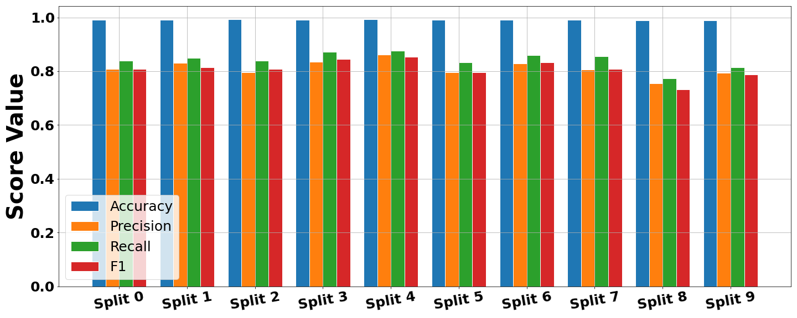
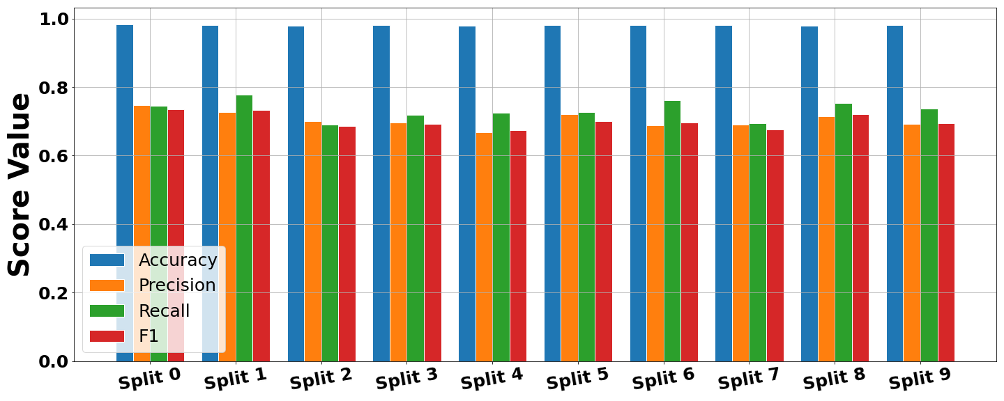
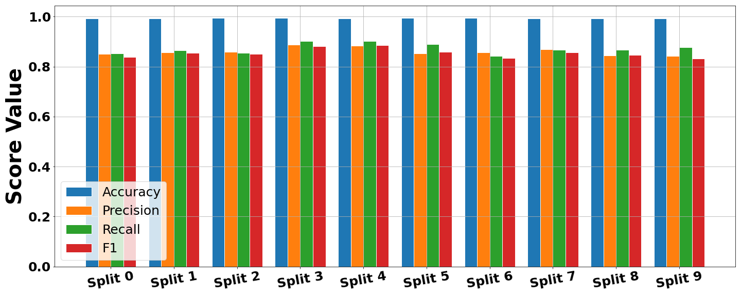
X-Validation Performance
1)
Compare three variants
CNN Architecture
MLP Architecture
Hybrid Architecture
Each unimodal architecture learns a set of parameters
2)
3)

Slide 20
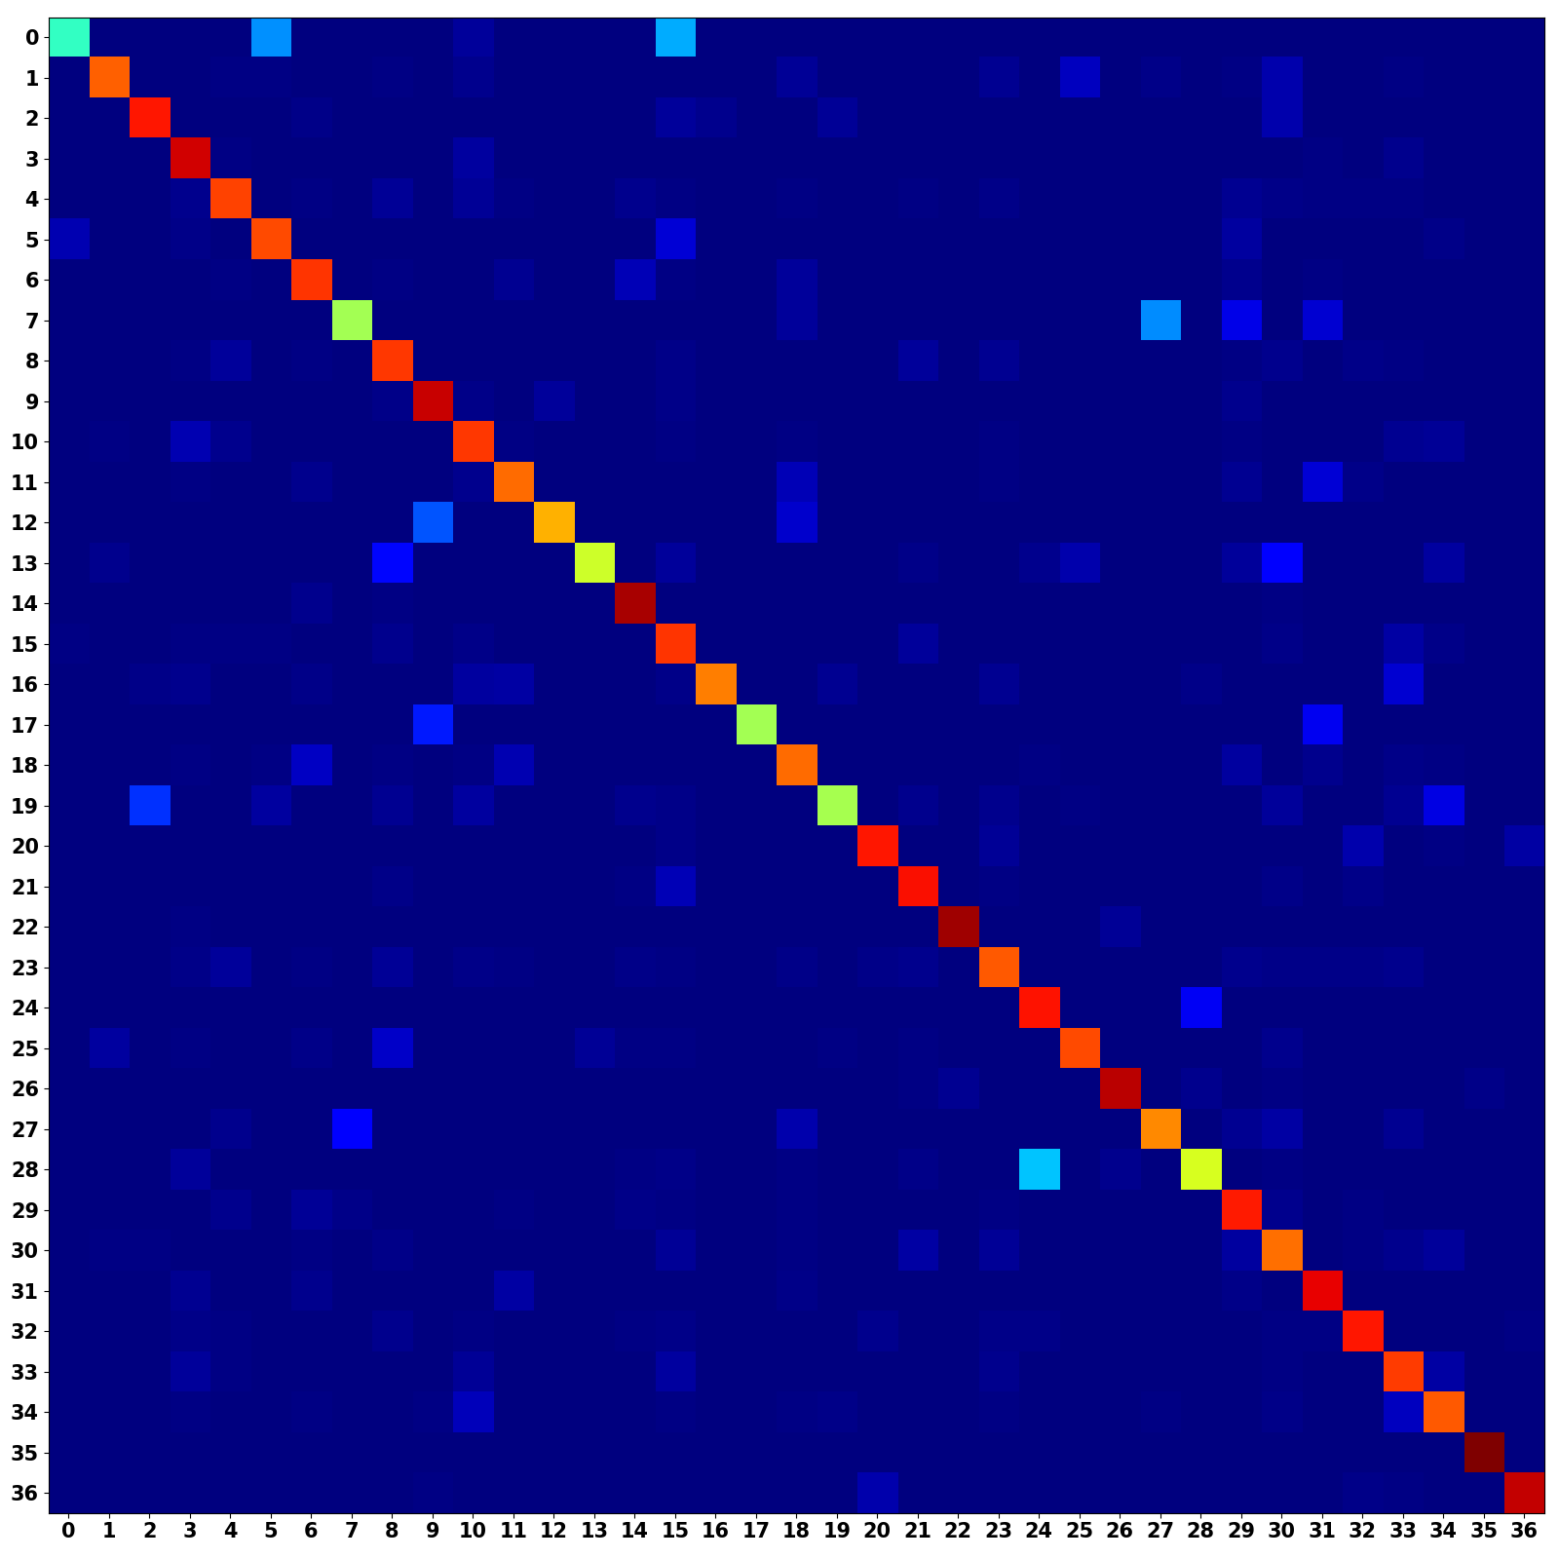
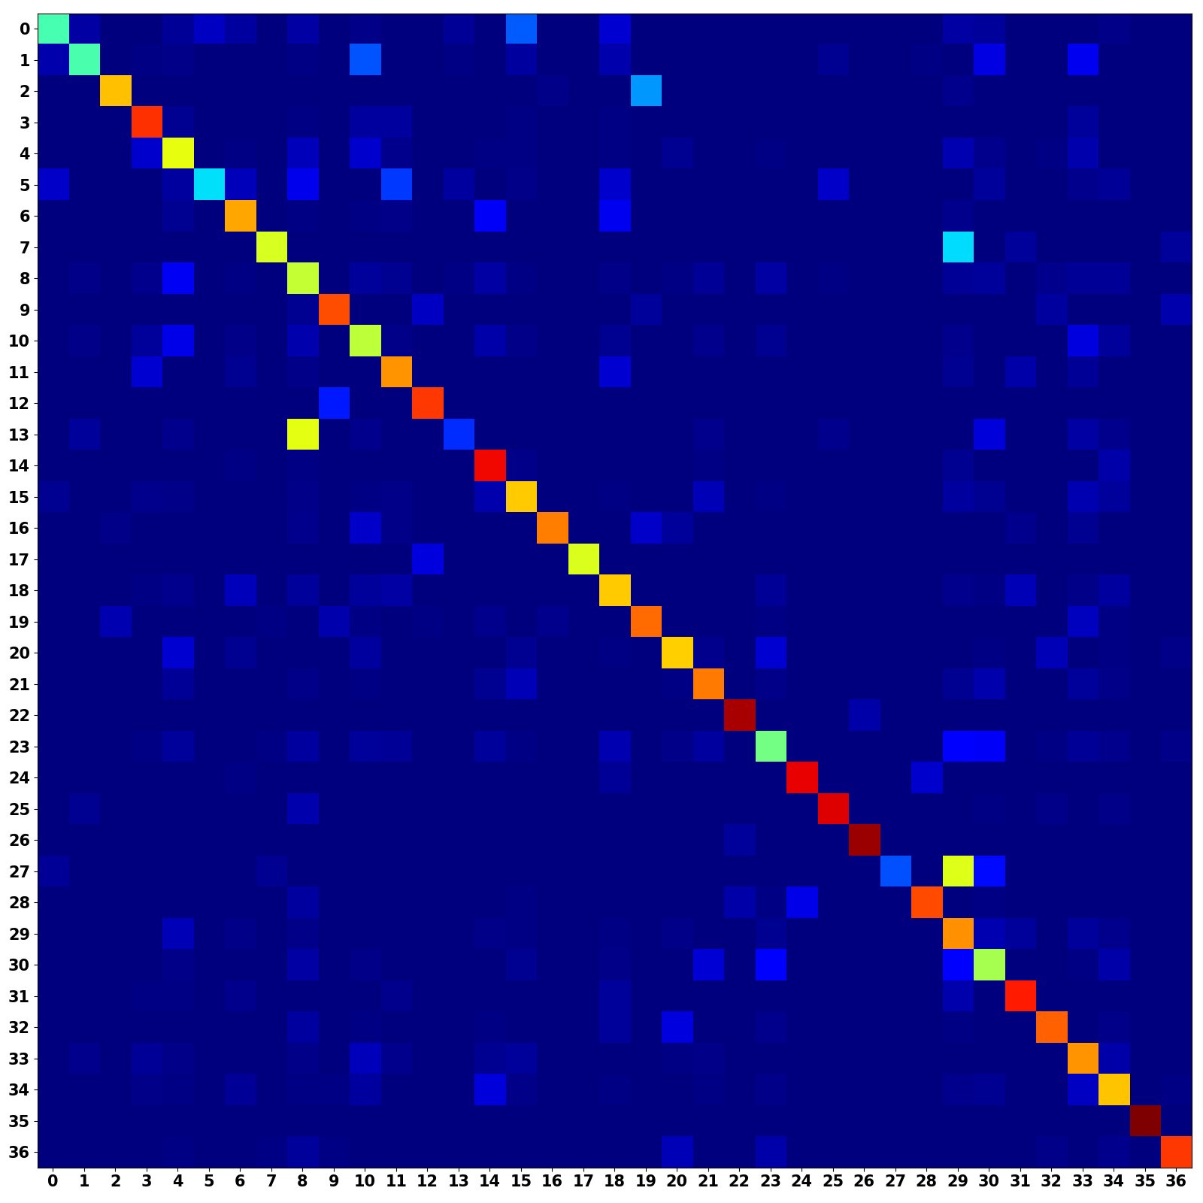
Unimodal Confusion Matrices
CNN Branch (Occurrence Weighted)
MLP Branch (Occurrence Weighted)

Slide 21
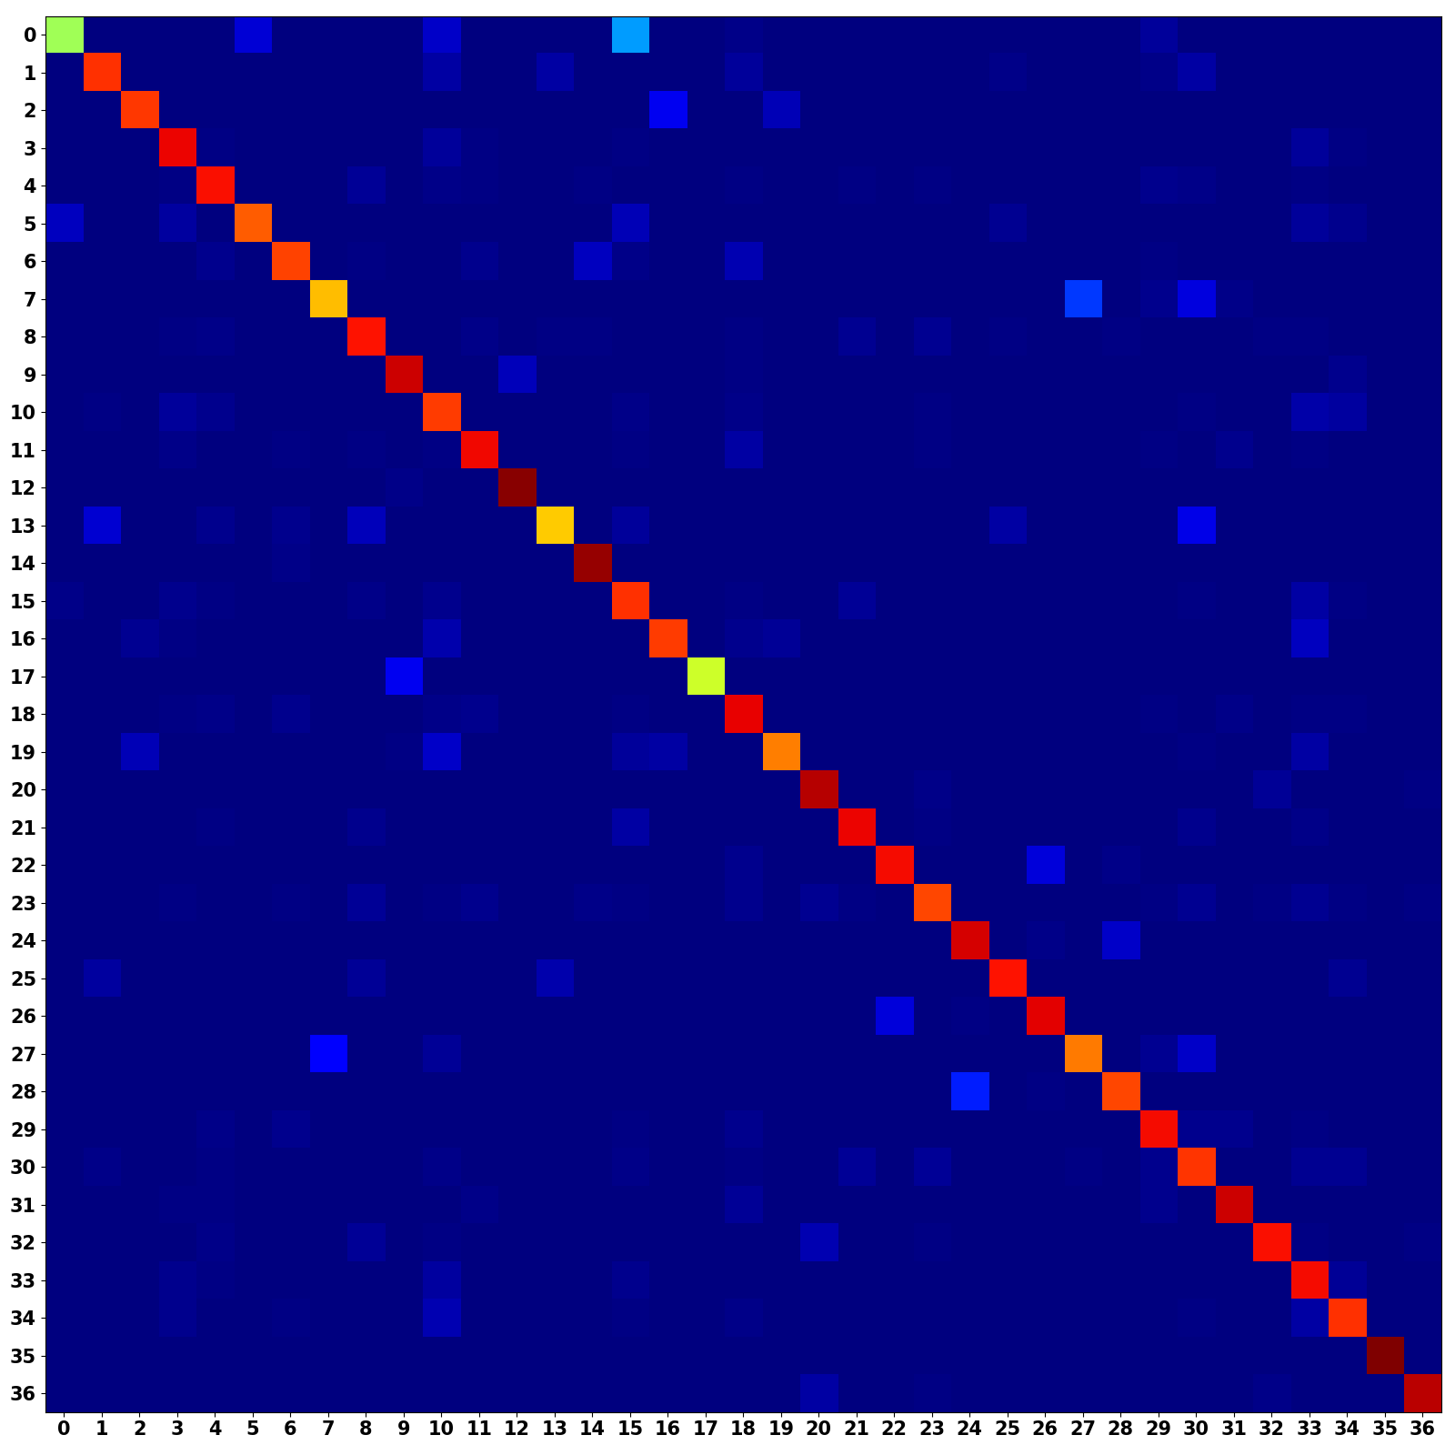
Multimodal Confusion Matrix
CNN + MLP (Occurrence Weighted)
Multimodal models shows a stronger main diagonal
Combines predictive power from both architectures

Slide 22
Discussions and Conclusions
Hybrid architecture allows for single sample to be effectively convey with two different input modes
The Multimodal Model Improves musical instrument classification performance
We would like to deploy this model to classify unlabeled chaotic synthesizer waveforms

Slide 23
Citations
[1] Geron, Aurelien. Hands-on Machine Learning with Scikit-Learn and TensorFlow: Concepts, Tools, and Techniques to Build Intelligent Systems. O’Reilly, 2017.
[2] Goodfellow, Ian, et al.Deep Learning. MIT Press, 2017.
[3] Khan, M. Kashif Saeed, and Wasfi G. Al-Khatib. “Machine-Learning Based Classification of Speech and Music.” Multimedia Systems, vol. 12, no. 1, 2006, pp. 55–67., doi:10.1007/s00530-006-0034-0.
[4] Li, Yingming, and Ming Yang. “A Survey of Multi-View Representation Learning.” Journal of LateX Class Files, vol. 14, no. 8, Aug. 2015.
[5] Liu, Zhu, et al. ”Audio Feature Extraction and Analysis for Scene Segmentation and Classification.” Journal of VLSI Signal Processing, vol. 20, 1998, pp. 61–79.
[6] Ngiam, Jiquan, et al. ”Multimodal Deep Learning.” 2011.
[7] TensorFlow: Large-scale machine learning on heterogeneous systems, 2015. Software available from tensorflow.org.
[8] Virtanen, Tuomas, et al. Computational Analysis of Sound Scenes and Events. Springer, 2018.
[9] White, Harvey Elliott, and Donald H. White. Physics and Music: the Science of Musical Sound. Dover Publications, Inc., 2019.

Slide 24
Questions?
Additional information, GitHub Repository, and Formal Write-Up is Available
Landon Buell – lhb1007@wildcats.unh.edu
Kevin Short – kevin.short@unh.edu

Slide 25
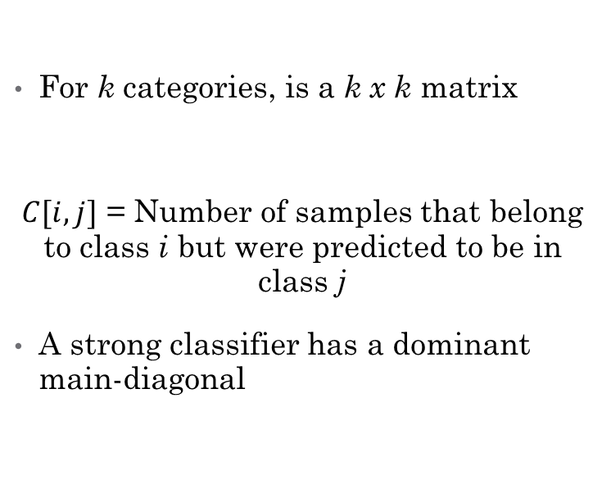
Appendix – Confusion Matrices
Standard Confusion Matrix
Occurrence Weighted Matrix
For k categories, is a k x k matrix
$C[i,j]$ = Number of samples that belong to class i but were predicted to be in class j
A strong classifier has a dominant main-diagonal
Create same as standard matrix
Divide each row by sum of the row
Accounts for non-uniform number of samples in each class

Slide 26
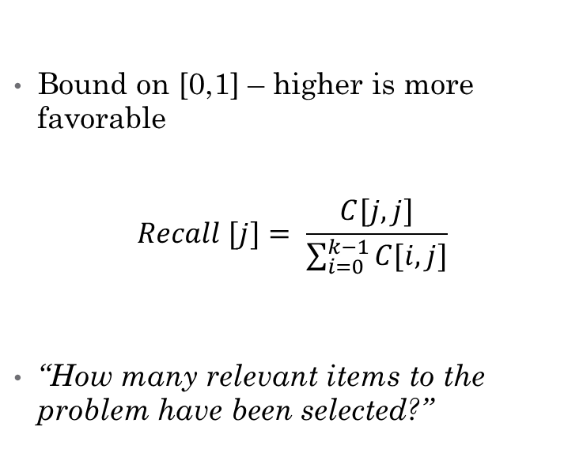
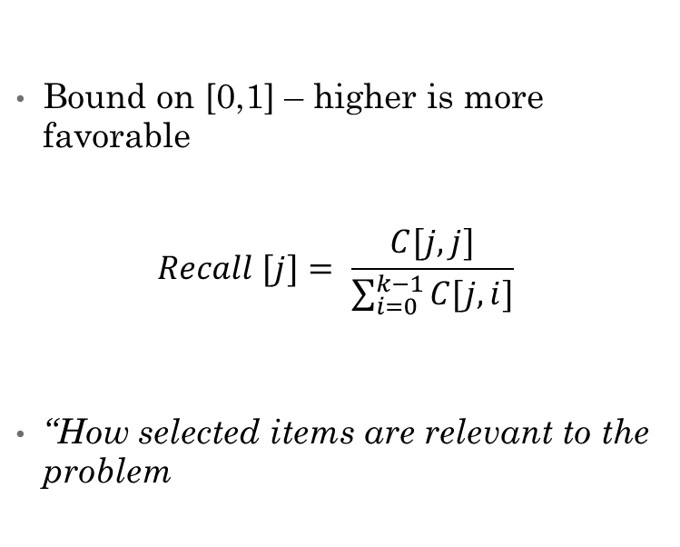
Appendix - Metrics
Precision / Sensitivity Score
Recall / Specificity Score
Bound on [0,1] – higher is more favorable
$$Recall [j]= \frac{C[j,j]}{\sum_{i=0}^{k−1}{C[j,i]}}$$
“How selected items are relevant to the problem
Bound on [0,1] – higher is more favorable
$$Recall [j]= \frac{C[j,j]}{\sum_{i=0}^{k−1}{C[i,j]}}$$
“How many relevant items to the problem have been selected?”

Slide 27
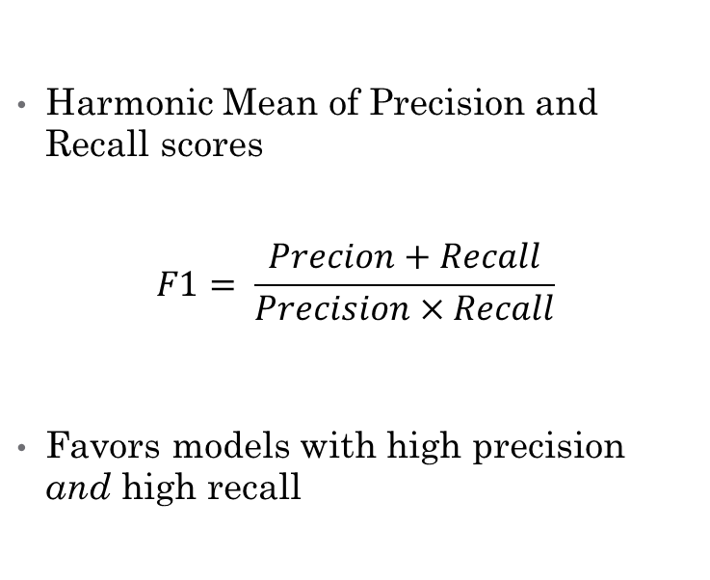
Appendix – Metrics (Cont.)
Accuracy Score
F1 Score
Ratio of correct predictions to total predictions
Often misleading, not commonly used
Does not account for non-uniform number of samples in each class
Harmonic Mean of Precision and Recall scores
$$F1= \frac{Precion+Recall}{Precision×Recall}$$
Favors models with high precision and high recall

